Slide 1
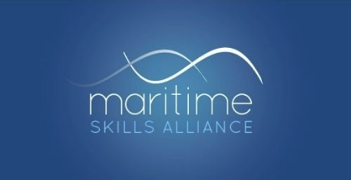
UK Maritime Qualifications
in a post-Brexit world
Iain Mackinnon
Maritime Skills Alliance

Slide 2
What I’ll cover
Recognition of Professional Qualifications in the EU since 1st January 2021
Turing Scheme: international mobility
The Maritime Skills Commission

Slide 3
Recognition of Professional Qualifications
Regulated professions
Seafarers – STCW
Non-regulated professions (eg RYA)

Slide 4
1 Regulated Professions
If your qualification has already been recognised by the relevant regulator in an EEA country or Switzerland, you don’t need to do anything
There are separate rules for certain professions, such as lawyers, auditors – and ‘sailors’ (seafarers)

Slide 5
Recognition of Professional Qualifications
If your UK qualification has not already been recognised you will need to apply to the appropriate regulator for your profession in each country where you intend to work.
You will need to do this even if you are only providing short-term or occasional professional services.

Slide 6
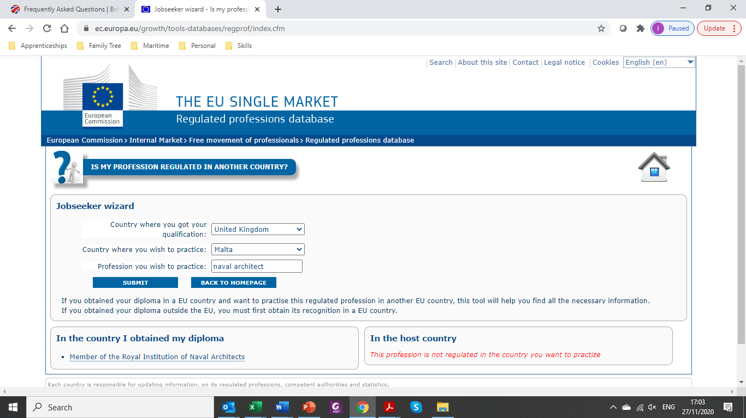
Country where you got your qualification
Country where you wish to practice
Profession you wish to practice
Result: “this profession is not regulated in the country you want to practice”
The “RegProf” database
https://ec.europa.eu/growth/tools-databases/regprof/index.cfm

Slide 7
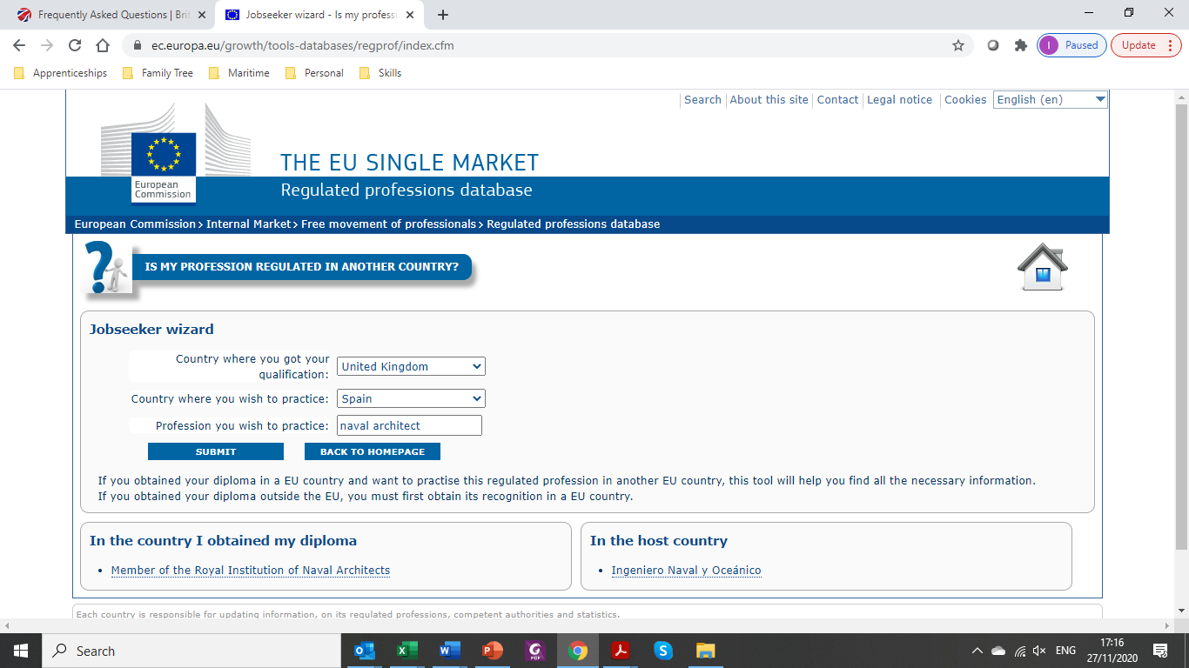
Result: “Ingeniero Naval y Oceánico”
https://ec.europa.eu/growth/tools-databases/regprof/index.cfm

Slide 8
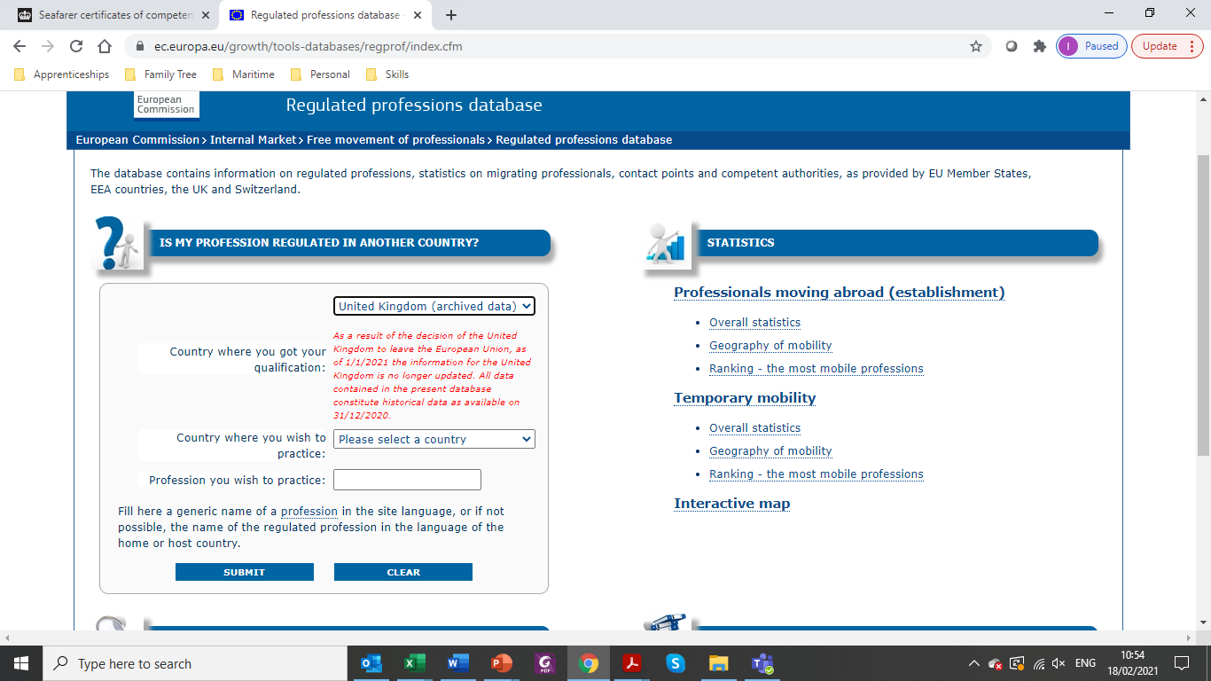
As a result of the decision of the United Kingdom to leave the European Union, as of 1/1/2021 the information for the United Kingdom is no longer updated. All data contained in the present database constitute historical data as available on 31/12/2020.
A new warning message added from 1st January

Slide 9
Is that a problem?
Not if we apply a dose of commonsense:
“I think that means that if I am a naval architect who qualified in the UK the database will continue to point me to the INO for Spain, and to tell me that naval architecture is not a regulated profession in Malta, and so on. What it won’t do is to pick up any changes at the UK end, eg if the Royal Institute of Naval Architecture (RINA) changes its approach, or ceases to exist. Have I understood that right?
If so, the disadvantage to UK users is very small, at least in the maritime sector. Professions change their approaches very slowly, and the chance that RINA will cease to exist, or cease to award certification, is effectively nil. So long as we can continue to access your database, and use some commonsense, we should be fine”.
My e-mail to the Commission, 20 Jan 2021

Slide 10
2 Seafarers:
“If you are working on a UK-flagged vessel and hold a certificate of competency, you will not need to take any action.
If you are working on a vessel that is flagged as either an EU country, Norway, Iceland or Liechtenstein, you will be able to work on it until your certificate of equivalent competency expires.
The government is working to ensure that the EU, Norway, Iceland and Liechtenstein will continue to accept UK certificates of competency.” - MCA
https://www.gov.uk/guidance/recognition-of-seafarer-certificates-of-competency-from-1-january-2021

Slide 11
3 Non-regulated professions
The RegProf database only covers regulated professions
There’s no structure for non-regulated professions
Reports of centres in Spain declining to recognise RYA certificates after 1st January for commercial use on Spanish-flagged vessels under 14m
Teething troubles? Straws in the wind?

Slide 12
From Erasmus to Turing
UK’s Turing Scheme will replace UK participation in the EU’s Erasmus programme
£110m initially to support 35,000 students to study and work abroad
not supporting incoming students
worldwide scope, not just Europe
An opportunity for an ambitious internationally-focused sector
www.turing-scheme.org.uk

Slide 13
Maritime Skills Commission
set up to lead the sector’s work in ensuring that businesses across the whole sector have the people they need to flourish
recommendation from Maritime 2050 strategy
reports jointly to the Maritime Minister & Maritime UK
… Annual Report + 5-yearly “State of the Nation”
started work July 2020

Slide 14
Maritime Skills Commission – Objectives
Understand the skills needs of the sector, including the effects of technological change, and to make recommendations for action
Ensure that no part of the sector suffers from serious skills shortages or skills gaps
Ensure that the sector has the apprenticeships and qualifications it needs
Ensure the sector has the training provision it needs
Provide employers and individuals with clear information about career paths and re-training options
Ensuring that employers have good quality recruits for their vacancies through effective promotion of maritime careers
Increase exports of maritime education and training

Slide 15
Maritime Skills Commission – story so far
Labour Market Scoping Report
First Annual Report
Seafarer Cadet Review – Brian Johnson chairing
Online Learning
Port of the Future
Promoting exports
New qualification for careers ashore
Labour market survey (not agreed yet)

Slide 16
iain@maritimeskills.org
0208 99 88 77 2
www.maritimeskills.org
www.MaritimeSkillsCommission.uk

